Slide 1
Chapter 2: Relational Model

Slide 2
Relational Algebra
Procedural language
Six basic operators
  select: σ
  project: ∏
  union: ∪
  set difference: –
  Cartesian product: x
  rename: ρ
The operators take one or two relations as inputs and produce a new relation as a result.

Slide 3
Select Operation – Example
Relation r
A
B
C
D
α
α
β
β
α
β
β
β
1
5
12
23
7
7
3
10
σ_{A=B ^ D > 5} (r)
A
B
C
D
α
β
α
β
1
23
7
10

Slide 4
Select Operation
Notation: σ _{p}(r)
p is called the selection predicate
Defined as:
σ_{p}(r) = {t | t ∈ r and p(t)}
Where p is a formula in propositional calculus consisting of terms connected by : ∧ (and), ∨ (or), ¬ (not)
Each term is one of:
<attribute> op <attribute> or <constant>
where op is one of: =, ≠, >, ≥. <. ≤
Example of selection:
σ _{branch_name=“Perryridge”}(account)

Slide 5
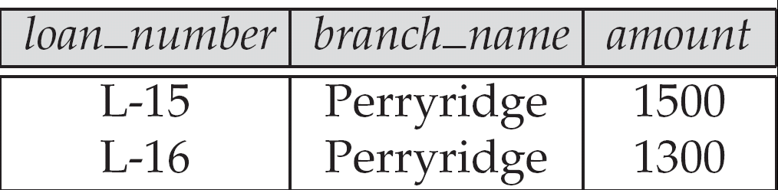
Figure 2.9
Result of σ_{branch_name = “Perryridge”} (loan)

Slide 6
Project Operation – Example
A
B
C
Relation r:
α
α
β
β
10
20
30
40
1
1
1
2
A
C
A
C
∏_{A,C} (r)
α
α
β
β
1
1
1
2
α
β
β
1
1
2
=

Slide 7

Project Operation
Notation:
where A₁, A₂ are attribute names and r is a relation name.
The result is defined as the relation of k columns obtained by erasing the columns that are not listed
Duplicate rows removed from result, since relations are sets
Example: To eliminate the branch_name attribute of account
∏_{account_number, balance} (account)

Slide 8
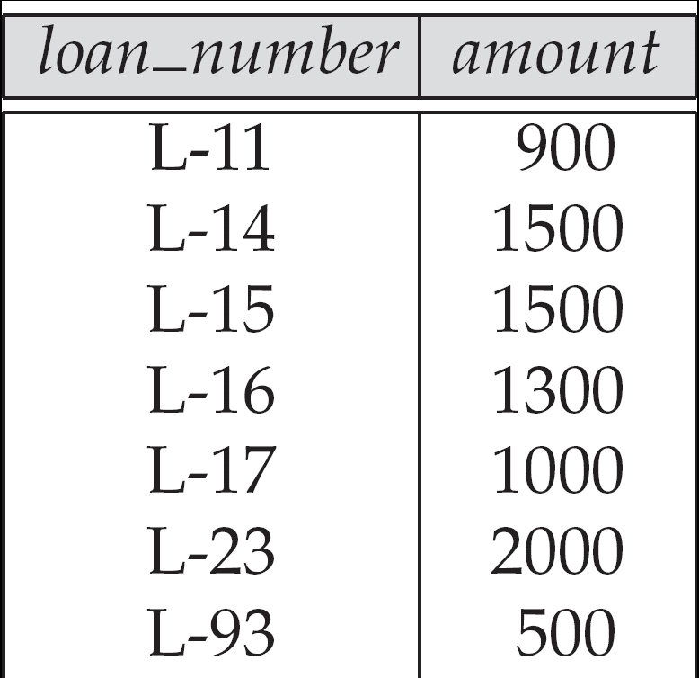
Figure 2.10:
Loan number and the amount of the loan

Slide 9
Composition of Relational Operations
Find the customer who live in Harrison
  ∏_{customer_name} (σ _{customer_city=”Harrison}” (customer))
Notice that instead of giving the name of a relation as the argument of the projection operation, we give an expression that evaluates to a relation

Slide 10
Union Operation – Example
Relations r, s:
A
B
A
B
α
α
β
1
2
1
α
β
2
3
s
r
A
B
α
α
β
β
1
2
1
3
r ∪ s:

Slide 11
Union Operation
Notation: r ∪ s
Defined as:
r ∪ s = {t | t ∈ r or t ∈ s}
For r ∪ s to be valid.
1. r, s must have the same arity (same number of attributes)
2. The attribute domains must be compatible (example: 2nd column
of r deals with the same type of values as does the 2nd
column of s)
Example: to find all customers with either an account or a loan
∏_{customer_name} (depositor) ∪ ∏_{customer_name} (borrower)

Slide 12
Set Difference Operation – Example
Relations r, s:
A
B
A
B
α
α
β
1
2
1
α
β
2
3
s
r
r – s:
A
B
α
β
1
1

Slide 13
Set Difference Operation
Notation r – s
Defined as:
r – s = {t | t ∈ r and t ∉ s}
Set differences must be taken between compatible relations.
  r and s must have the same arity
  attribute domains of r and s must be compatible

Slide 14
Cartesian-Product Operation – Example
Relations r, s:
A
B
C
D
E
α
β
1
2
α
β
β
γ
10
10
20
10
a
a
b
b
r
s
r x s:
A
B
C
D
E
α
α
α
α
β
β
β
β
1
1
1
1
2
2
2
2
α
β
β
γ
α
β
β
γ
10
10
20
10
10
10
20
10
a
a
b
b
a
a
b
b

Slide 15
Cartesian-Product Operation
Notation r x s
Defined as:
r x s = {t q | t ∈ r and q ∈ s}
Assume that attributes of r(R) and s(S) are disjoint. (That is, R ∩ S = ∅).
If attributes of r(R) and s(S) are not disjoint, then renaming must be used.

Slide 16
Composition of Operations
Can build expressions using multiple operations
Example: σ_{A=C}(r x s)
r x s
σ_{A=C}(r x s)
A
B
C
D
E
α
α
α
α
β
β
β
β
1
1
1
1
2
2
2
2
α
β
β
γ
α
β
β
γ
10
10
20
10
10
10
20
10
a
a
b
b
a
a
b
b
A
B
C
D
E
α
β
β
1
2
2
α
β
β
10
10
20
a
a
b

Slide 17

Rename Operation
Allows us to name, and therefore to refer to, the results of relational-algebra expressions.
Allows us to refer to a relation by more than one name.
Example:
ρ _{x} (E)
returns the expression E under the name X
If a relational-algebra expression E has arity n, then
returns the result of expression E under the name X, and with the
attributes renamed to A₁ , A₂ , …., A_{n} .

Slide 18
Banking Example
branch (branch_name, branch_city, assets)
customer (customer_name, customer_street, customer_city)
account (account_number, branch_name, balance)
loan (loan_number, branch_name, amount)
depositor (customer_name, account_number)
borrower (customer_name, loan_number)

Slide 19
Example Queries
Find all loans of over $1200
σ_{amount > 1200} (loan)
Find the loan number for each loan of an amount greater than $1200
∏_{loan_number} (σ_{amount} _{> 1200} (loan))
Find the names of all customers who have a loan, an account, or both, from the bank
  ∏_{customer_name} (borrower) ∪ ∏_{customer_name} (depositor)

Slide 20
Example Queries
Find the names of all customers who have a loan at the Perryridge branch.
∏_{customer_name} (σ_{branch_name=“Perryridge”}
(σborrower.loan_number = loan.loan_number(borrower x loan)))
Find the names of all customers who have a loan at the
Perryridge branch but do not have an account at any branch of
the bank.
∏_{customer_name} (σ_{branch_name = “Perryridge”}
(σborrower.loan_number = loan.loan_number(borrower x loan))) –
∏_{customer_name}(depositor)

Slide 21
Example Queries
Find the names of all customers who have a loan at the Perryridge branch.
  Query 1
  ∏_{customer_name} (σ_{branch_name = “Perryridge”} (
  σborrower.loan_number = loan.loan_number (borrower x loan)))
  Query 2
  ∏_{customer_name}(σloan.loan_number = borrower.loan_number (
  (σ_{branch_name = “Perryridge”} (loan)) x borrower))

Slide 22
Example Queries
Find the largest account balance
  Strategy:
    Find those balances that are not the largest
      Rename account relation as d so that we can compare each account balance with all others
    Use set difference to find those account balances that were not found in the earlier step.
  The query is:
∏_{balance}(account) - ∏_{account.balance}
(σ_{account.balance < d.balance} (account x ρ_{d} (account)))

Slide 23
Formal Definition
A basic expression in the relational algebra consists of either one of the following:
  A relation in the database
  A constant relation
Let E₁ and E₂ be relational-algebra expressions; the following are all relational-algebra expressions:
  E₁ ∪ E₂
  E₁ – E₂
  E₁ x E₂
  σ_{p} (E₁), P is a predicate on attributes in E₁
  ∏_{s}(E₁), S is a list consisting of some of the attributes in E₁
  ρ _{x} (E₁), x is the new name for the result of E₁

Slide 24
Additional Operations
We define additional operations that do not add any power to the
relational algebra, but that simplify common queries.
Set intersection
Natural join
Division
Assignment

Slide 25
Set-Intersection Operation
Notation: r ∩ s
Defined as:
r ∩ s = { t | t ∈ r and t ∈ s }
Assume:
  r, s have the same arity
  attributes of r and s are compatible
Note: r ∩ s = r – (r – s)

Slide 26
Set-Intersection Operation – Example
Relation r, s:
r ∩ s
A B
A B
α
α
β
1
2
1
α
β
2
3
r
s
A B
α 2

Slide 27
Natural-Join Operation
Notation: r s
Let r and s be relations on schemas R and S respectively.
Then, r s is a relation on schema R ∪ S obtained as follows:
  Consider each pair of tuples t_{r} from r and t_{s} from s.
  If t_{r} and t_{s} have the same value on each of the attributes in R ∩ S, add a tuple t to the result, where
    t has the same value as t_{r} on r
    t has the same value as t_{s} on s
Example:
  R = (A, B, C, D)
  S = (E, B, D)
  Result schema = (A, B, C, D, E)
  r s is defined as:
  ∏_{r.A, r.B, r.C, r.D, s.E} (σ_{r.B = s.B} ∧ _{r.D = s.D} (r x s))

Slide 28
Natural Join Operation – Example
Relations r, s:
A
B
C
D
B
D
E
α
β
γ
α
δ
1
2
4
1
2
α
γ
β
γ
β
a
a
b
a
b
1
3
1
2
3
a
a
a
b
b
α
β
γ
δ
∈
r
s
r s
A
B
C
D
E
α
α
α
α
δ
1
1
1
1
2
α
α
γ
γ
β
a
a
a
a
b
α
γ
α
γ
δ

Slide 29
Division Operation
r ÷ s
Notation:
Suited to queries that include the phrase “for all”.
Let r and s be relations on schemas R and S respectively where
  R = (A₁, …, A_{m} , B₁, …, B_{n} )
  S = (B₁, …, B_{n})
  The result of r ÷ s is a relation on schema
  R – S = (A₁, …, A_{m})
  r ÷ s = { t | t ∈ ∏ _{R-S} (r) ∧ ∀ u ∈ s ( tu ∈ r ) }
  Where tu means the concatenation of tuples t and u to produce a single tuple

Slide 30
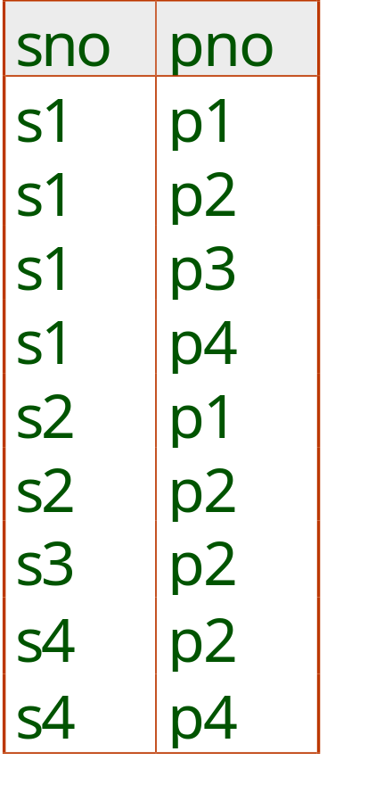
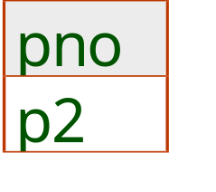
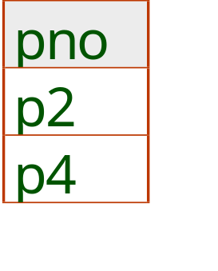
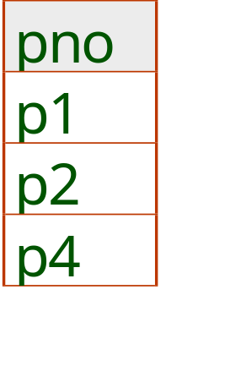
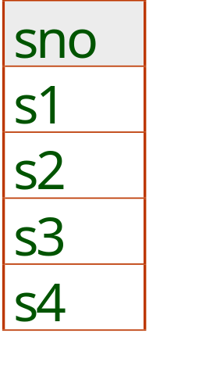
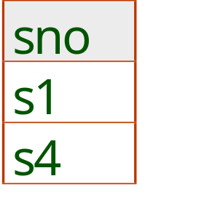
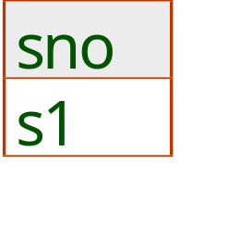
Examples of Division A/B
B1
B2
B3
A
A/B1
A/B2
A/B3
Notes:
14

Slide 31
Bank Example Queries
Find the names of all customers who have a loan and an account at bank.
  ∏_{customer_name} (borrower) ∩ ∏_{customer_name} (depositor)
Find the name of all customers who have a loan at the bank and the loan amount
  ∏customer_name, loan_number, amount (borrower loan)

Slide 32
Bank Example Queries
Find all customers who have an account from at least the “Downtown” and the Uptown” branches.
  Query 1
    ∏_{customer_name} (σ_{branch_name = “Downtown”} (depositor account )) ∩
    ∏_{customer_name} (σ_{branch_name = “Uptown”} (depositor account))

Slide 33
Extended Relational-Algebra-Operations
Generalized Projection
Aggregate Functions
Outer Join

Slide 34

Generalized Projection
Extends the projection operation by allowing arithmetic functions to be used in the projection list.
E is any relational-algebra expression
Each of F₁, F₂, …, F_{n} are are arithmetic expressions involving constants and attributes in the schema of E.
Given relation credit_info(customer_name, limit, credit_balance), find how much more each person can spend:
∏customer_name, limit – credit_balance (credit_info)

Slide 35

Aggregate Functions and Operations
Aggregation function takes a collection of values and returns a single value as a result.
avg: average value
min: minimum value
max: maximum value
sum: sum of values
count: number of values
Aggregate operation in relational algebra
E is any relational-algebra expression
  G₁, G₂ …, G_{n} is a list of attributes on which to group (can be empty)
  Each F_{i} is an aggregate function
  Each A_{i} is an attribute name

Slide 36
Aggregate Operation – Example
Relation r:
A
B
C
α
α
β
β
α
β
β
β
7
7
3
10
g _{sum(c)} (r)
sum(c )
27

Slide 37
Aggregate Operation – Example
Relation account grouped by branch-name:
branch_name
account_number
balance
Perryridge
Perryridge
Brighton
Brighton
Redwood
A-102
A-201
A-217
A-215
A-222
400
900
750
750
700
_{branch_name} g _{sum(balance)} (account)
branch_name
sum(balance)
Perryridge
Brighton
Redwood
1300
1500
700

Slide 38
Aggregate Functions (Cont.)
Result of aggregation does not have a name
  Can use rename operation to give it a name
  For convenience, we permit renaming as part of aggregate operation
_{branch_name} g _{sum(balance) as sum_balance} (account)

Slide 39
Outer Join
An extension of the join operation that avoids loss of information.
Computes the join and then adds tuples form one relation that does not match tuples in the other relation to the result of the join.
Uses null values:
  null signifies that the value is unknown or does not exist
  All comparisons involving null are (roughly speaking) false by definition.
    We shall study precise meaning of comparisons with nulls later

Slide 40
Outer Join – Example
Relation loan
loan_number
branch_name
amount
L-170
L-230
L-260
Downtown
Redwood
Perryridge
3000
4000
1700
Relation borrower
customer_name
loan_number
Jones
Smith
Hayes
L-170
L-230
L-155

Slide 41
Outer Join – Example
Join
loan borrower
loan_number
branch_name
amount
customer_name
L-170
L-230
Downtown
Redwood
3000
4000
Jones
Smith
Left Outer Join
loan borrower
loan_number
branch_name
amount
customer_name
L-170
L-230
L-260
Downtown
Redwood
Perryridge
3000
4000
1700
Jones
Smith
null

Slide 42
Outer Join – Example
Right Outer Join
loan borrower
loan_number
branch_name
amount
customer_name
L-170
L-230
L-155
Downtown
Redwood
null
3000
4000
null
Jones
Smith
Hayes
Full Outer Join
loan borrower
loan_number
branch_name
amount
customer_name
L-170
L-230
L-260
L-155
Downtown
Redwood
Perryridge
null
3000
4000
1700
null
Jones
Smith
null
Hayes

Slide 43
Null Values
It is possible for tuples to have a null value, denoted by null, for some of their attributes
null signifies an unknown value or that a value does not exist.
The result of any arithmetic expression involving null is null.
Aggregate functions simply ignore null values (as in SQL)
For duplicate elimination and grouping, null is treated like any other value, and two nulls are assumed to be the same (as in SQL)

Slide 44
Null Values
Comparisons with null values return the special truth value: unknown
  If false was used instead of unknown, then not (A < 5)
  would not be equivalent to A >= 5
Three-valued logic using the truth value unknown:
  OR: (unknown or true) = true,
  (unknown or false) = unknown
  (unknown or unknown) = unknown
  AND: (true and unknown) = unknown,
  (false and unknown) = false,
  (unknown and unknown) = unknown
  NOT: (not unknown) = unknown
  In SQL “P is unknown” evaluates to true if predicate P evaluates to unknown
Result of select predicate is treated as false if it evaluates to unknown

Slide 45
Modification of the Database
The content of the database may be modified using the following operations:
  Deletion
  Insertion
  Updating
All these operations are expressed using the assignment operator.

Slide 46
Deletion
A delete request is expressed similarly to a query, except instead of displaying tuples to the user, the selected tuples are removed from the database.
Can delete only whole tuples; cannot delete values on only particular attributes
A deletion is expressed in relational algebra by:
r ← r – E
where r is a relation and E is a relational algebra query.

Slide 47
Deletion Examples
Delete all account records in the Perryridge branch.
account ← account – σ _{branch_name = “Perryridge”} (account )
Delete all loan records with amount in the range of 0 to 50
loan ← loan – σ _{amount ≥ 0 and amount ≤ 50} (loan)
Delete all accounts at branches located in Needham.
r₁ ← σ _{branch_city = “Needham”} (account branch )
r₂ ← ∏ _{account_number,} _{branch_name, balance} (r₁)
r₃ ← ∏ _{customer_name, account_number} (r₂ depositor)
account ← account – r₂
depositor ← depositor – r₃

Slide 48
Insertion
To insert data into a relation, we either:
  specify a tuple to be inserted
  write a query whose result is a set of tuples to be inserted
in relational algebra, an insertion is expressed by:
r ← r ∪ E
where r is a relation and E is a relational algebra expression.
The insertion of a single tuple is expressed by letting E be a constant relation containing one tuple.

Slide 49
Insertion Examples
Insert information in the database specifying that Smith has $1200 in account A-973 at the Perryridge branch.
account ← account ∪ {(“A-973”, “Perryridge”, 1200)}
depositor ← depositor ∪ {(“Smith”, “A-973”)}
Provide as a gift for all loan customers in the Perryridge
branch, a $200 savings account. Let the loan number serve
as the account number for the new savings account.
r₁ ← (σ_{branch_name = “Perryridge”} (borrower loan))
account ← account ∪ ∏_{loan_number, branch_name, 200} (r₁)
depositor ← depositor ∪ ∏_{customer_name, loan_number} (r₁)

Slide 50

Updating
A mechanism to change a value in a tuple without charging all values in the tuple
Use the generalized projection operator to do this task
Each F_{i} is either
  the I ^{th} attribute of r, if the I ^{th} attribute is not updated, or,
  if the attribute is to be updated F_{i} is an expression, involving only constants and the attributes of r, which gives the new value for the attribute

Slide 51
Update Examples
Make interest payments by increasing all balances by 5 percent.
account ← ∏ account_number, branch_name, balance * 1.05 (account)
Pay all accounts with balances over $10,000 6 percent interest
and pay all others 5 percent
account ← ∏ account_number, branch_name, balance * 1.06 (σ _{BAL > 10000} (account ))
∪ ∏ account_number, branch_name, balance * 1.05 (σ_{BAL ≤ 10000} (account))

Slide 52
End of Chapter 2

Slide 53
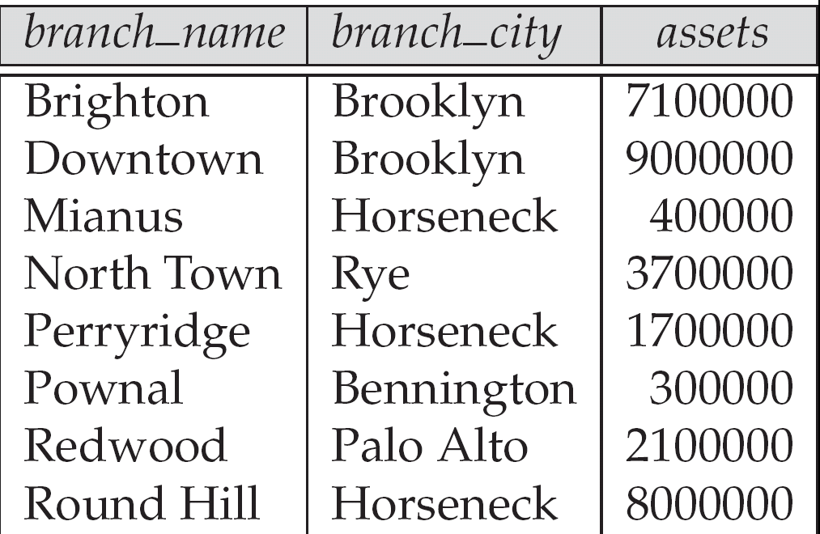
Figure 2.3. The branch relation

Slide 54

Figure 2.6: The loan relation

Slide 55
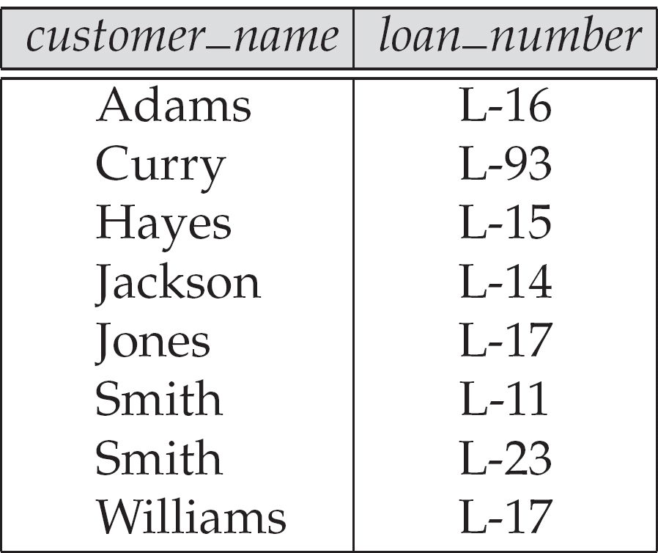
Figure 2.7: The borrower relation

Slide 56
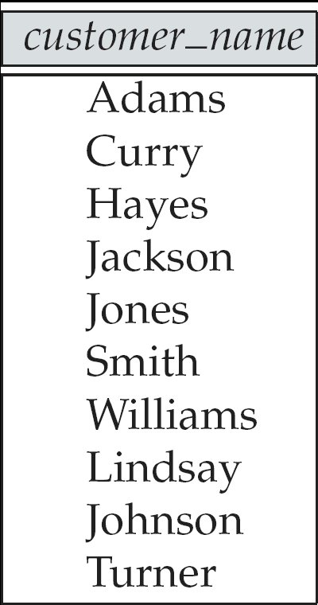
Figure 2.11: Names of all customers who have either an account or an loan

Slide 57
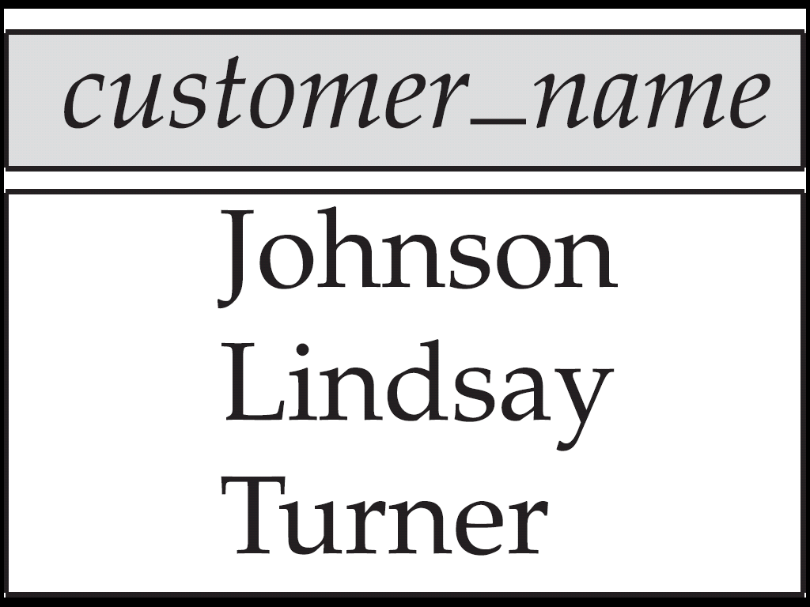
Figure 2.12:
Customers with an account but no loan

Slide 58
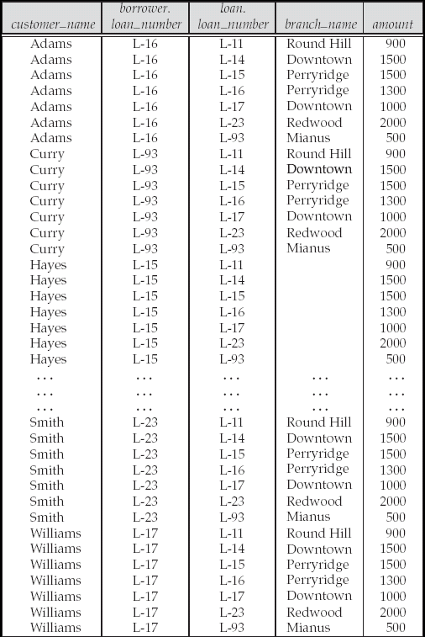
Figure 2.13: Result of borrower |X| loan

Slide 59
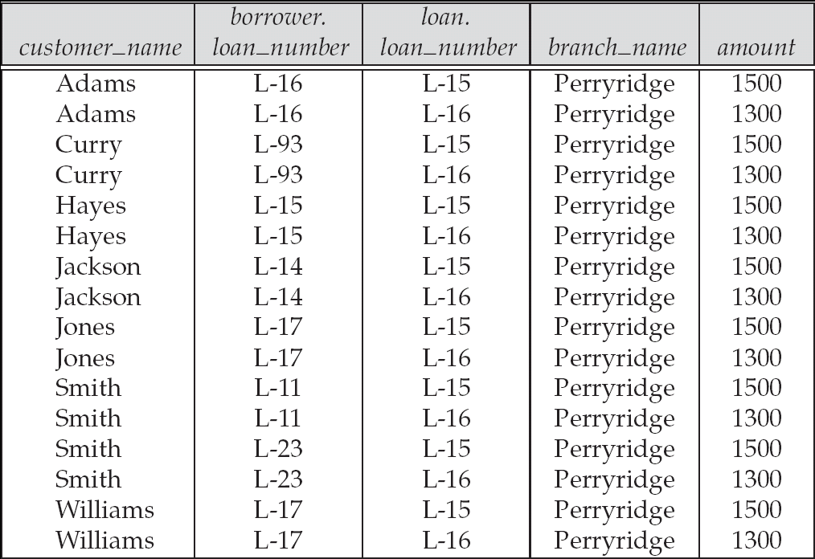
Figure 2.14

Slide 60
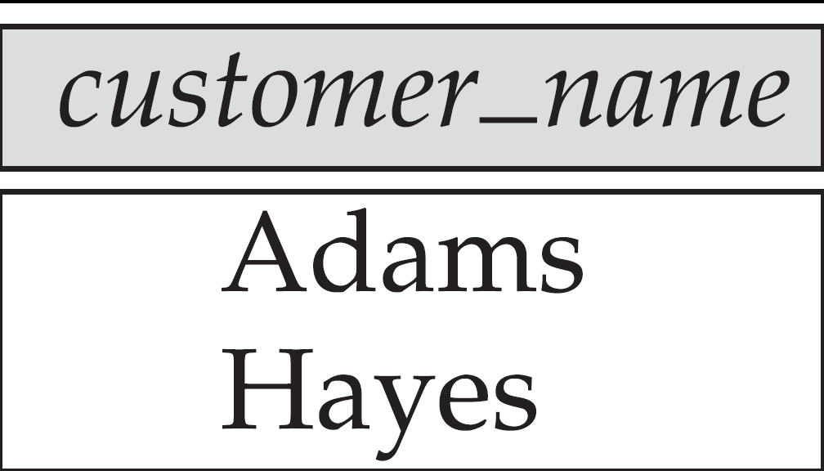
Figure 2.15

Slide 61
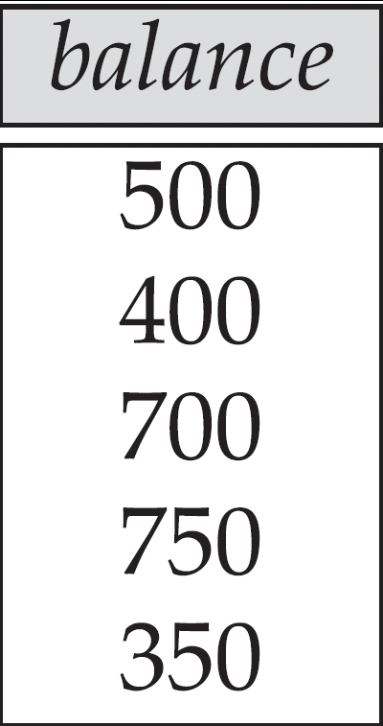
Figure 2.16

Slide 62
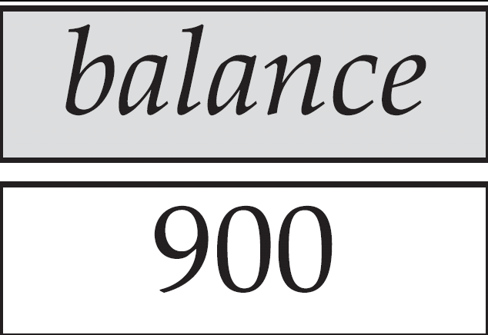
Figure 2.17
Largest account balance in the bank

Slide 63
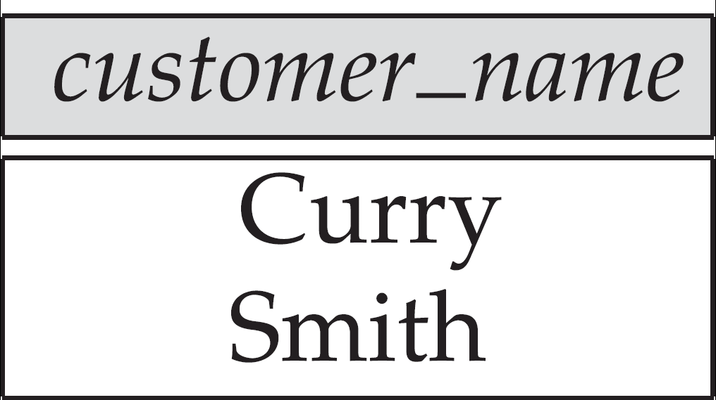
Figure 2.18: Customers who live on the same street and in the same city as Smith

Slide 64
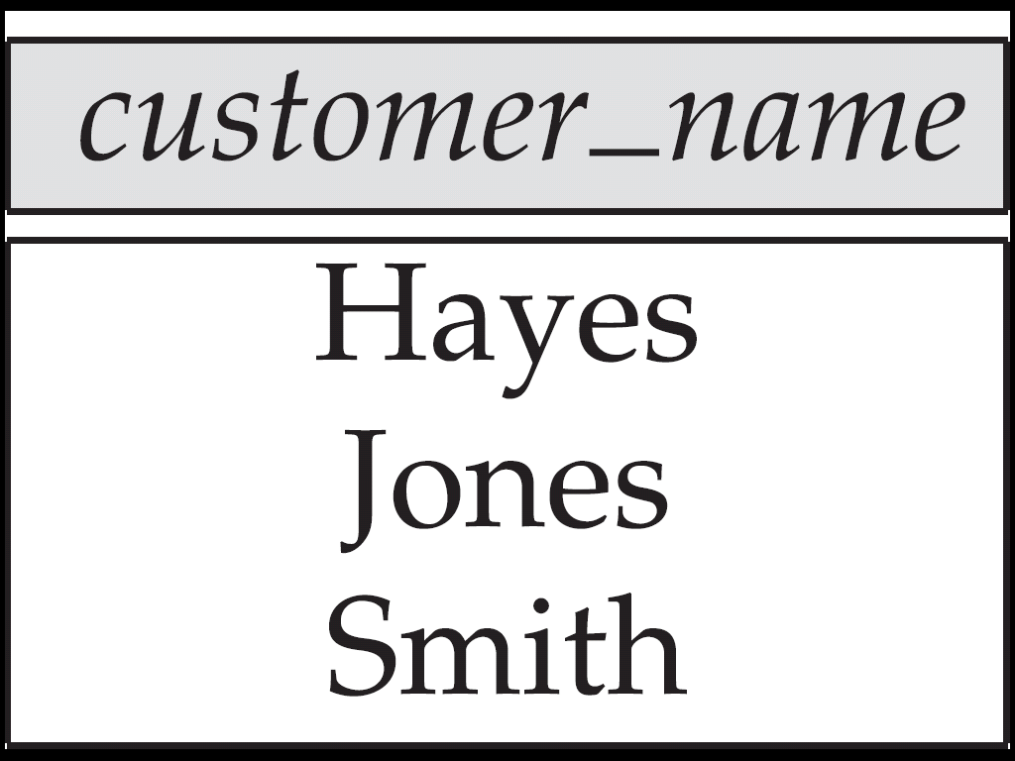
Figure 2.19: Customers with both an account and a loan at the bank

Slide 65
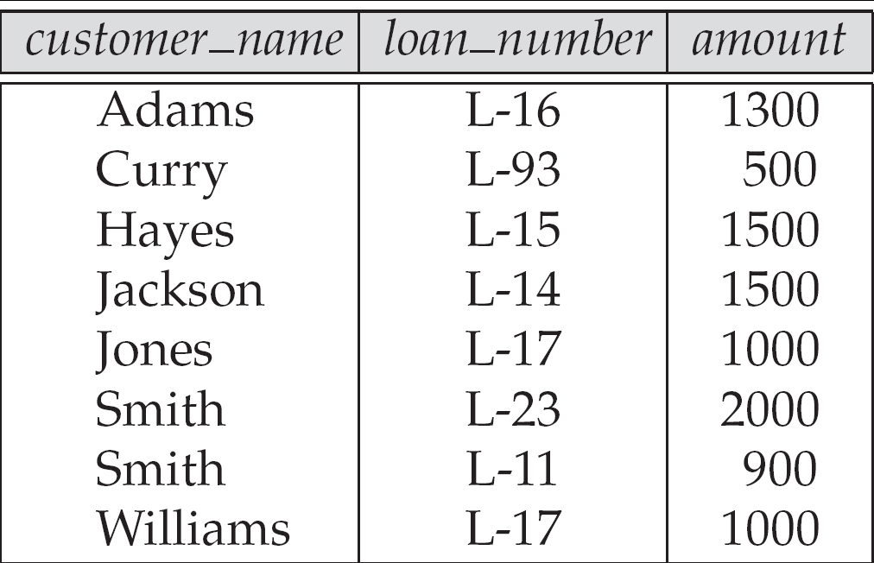
Figure 2.20

Slide 66
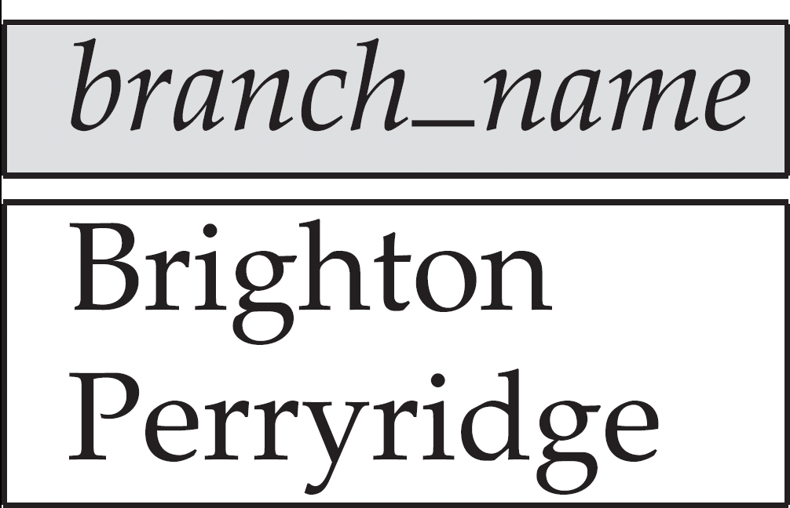
Figure 2.21

Slide 67
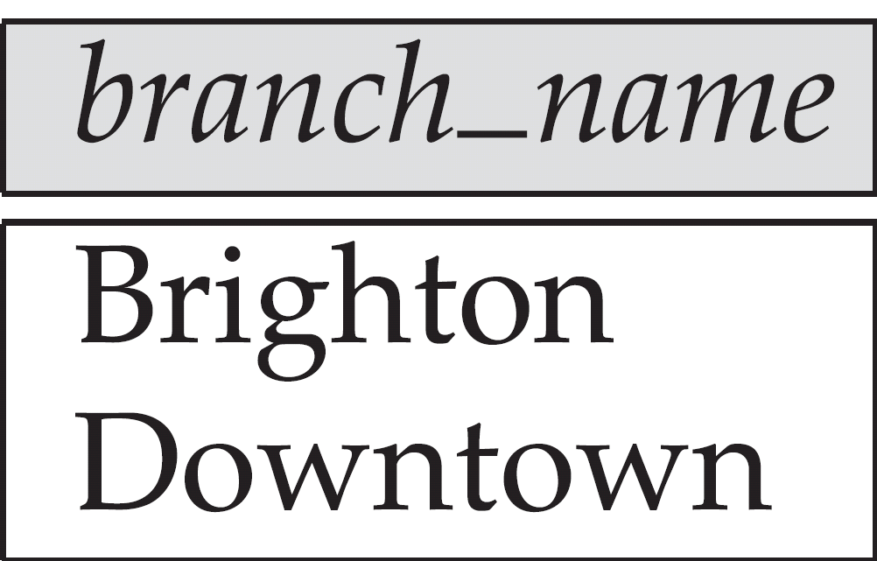
Figure 2.22

Slide 68
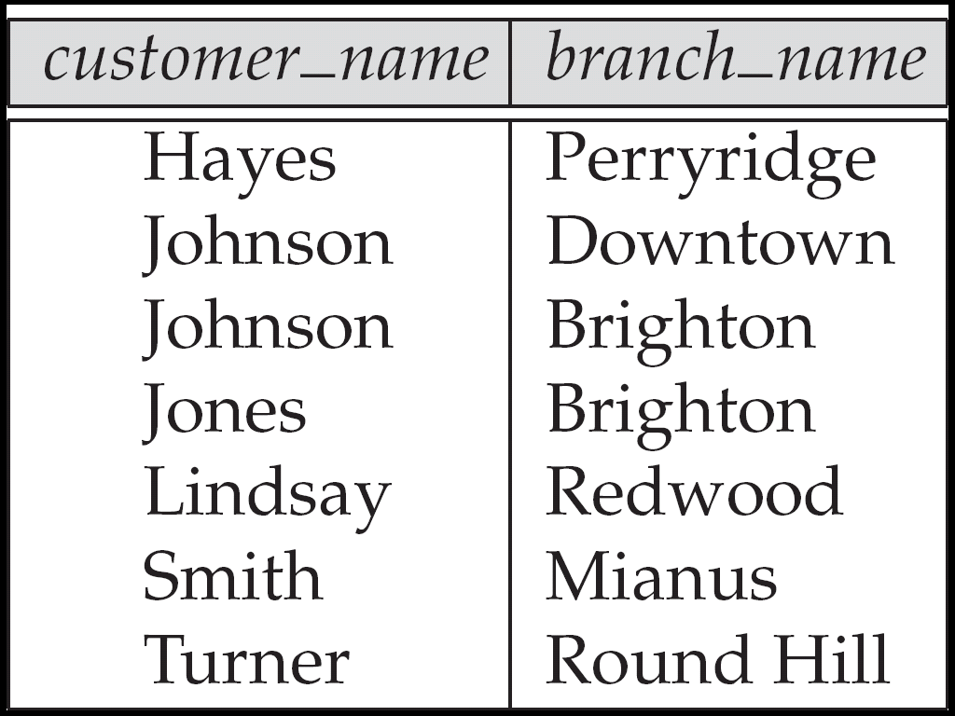
Figure 2.23

Slide 69
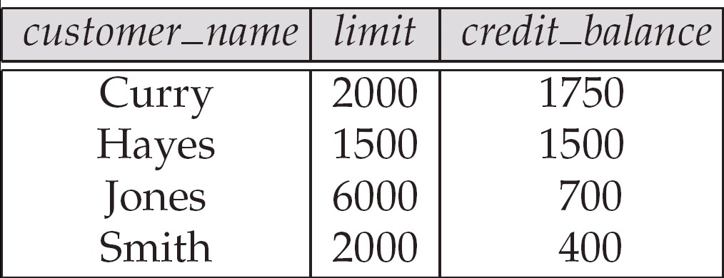
Figure 2.24: The credit_info relation

Slide 70
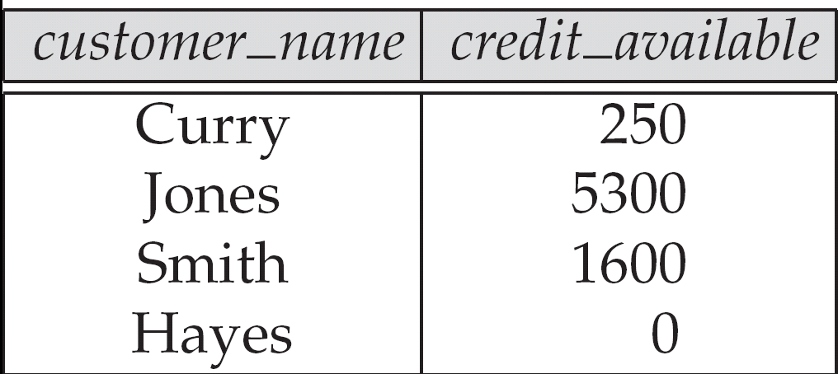
Figure 2.25

Slide 71
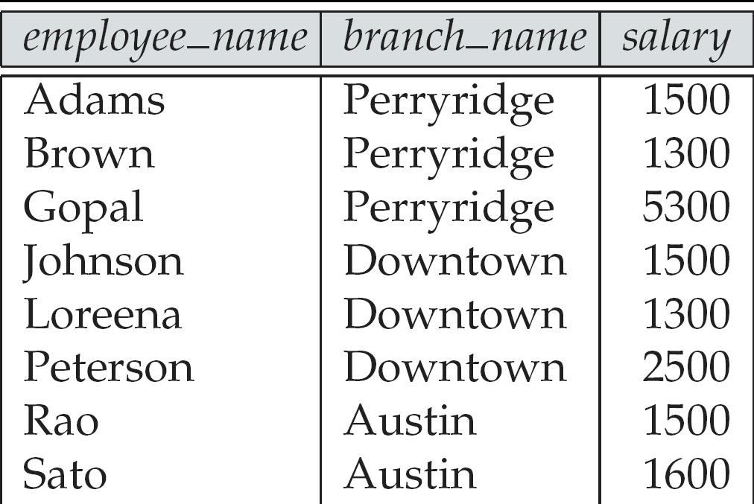
Figure 2.26: The pt_works relation

Slide 72
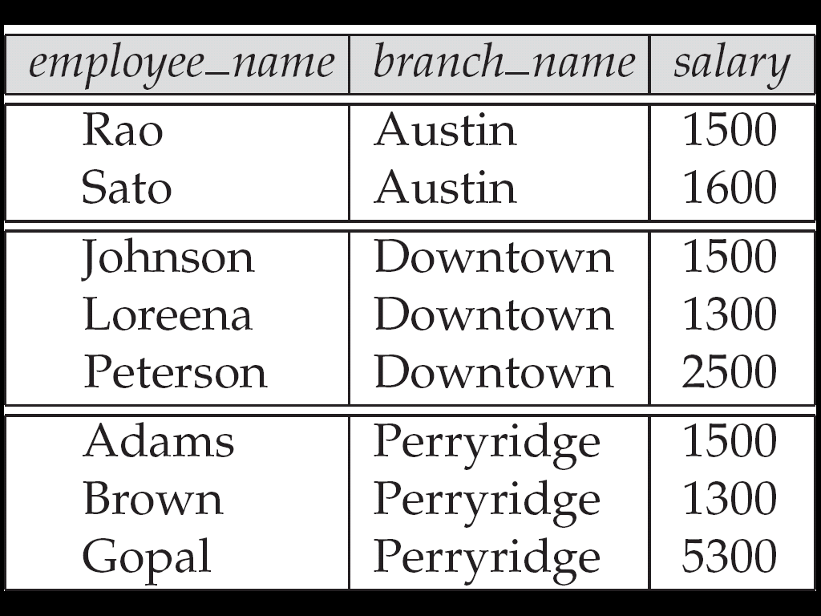
Figure 2.27
The pt_works relation after regrouping

Slide 73
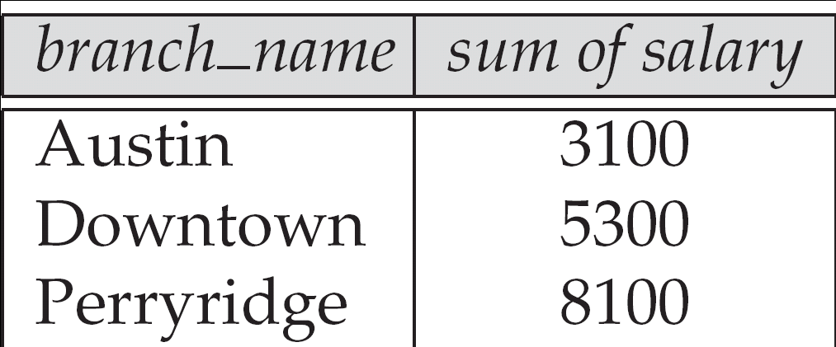
Figure 2.28

Slide 74
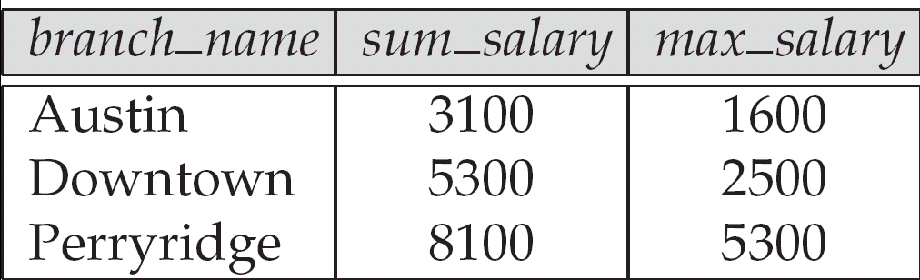
Figure 2.29

Slide 75
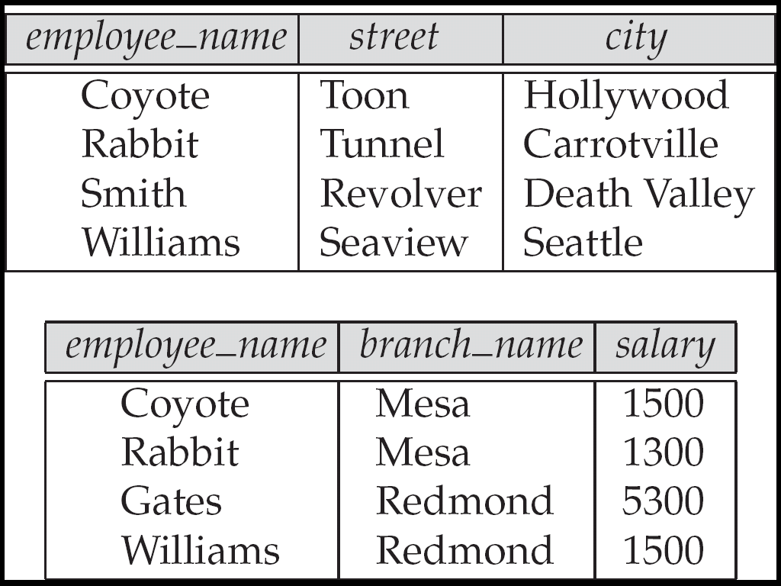
Figure 2.30
The employee and ft_works relations

Slide 76
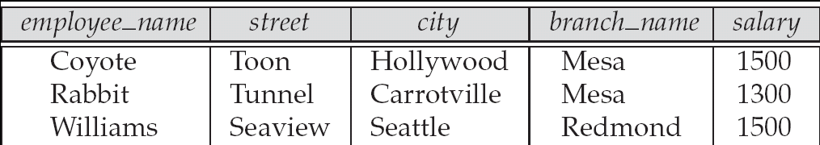
Figure 2.31

Slide 77
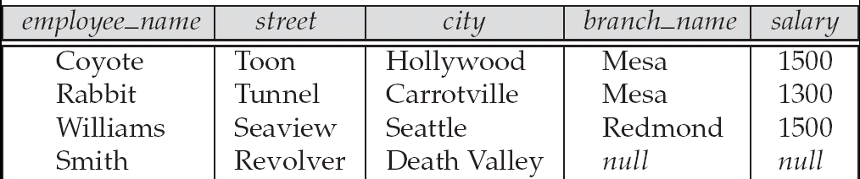
Figure 2.32

Slide 78
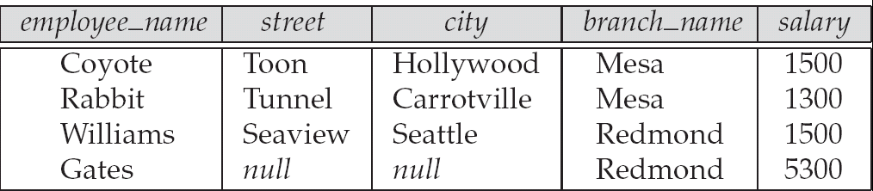
Figure 2.33

Slide 79
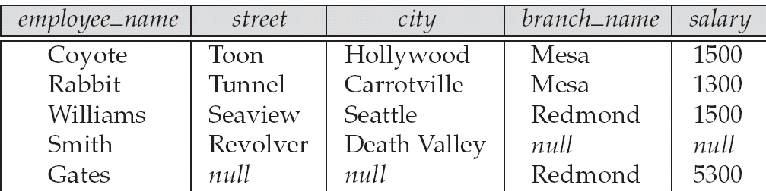
Figure 2.34

